Slide 1
Stock Market Analysis
Zachary Herrington, Molly Oesterling, Tomorrow Rose, Chris Waycott

Slide 2
Our Data
Historical stock price data for technology stocks
New York Stock Exchange (NYSE) | London Stock Exchange (LSE) | Over the Counter Markets (OTCMKTS)
Apple (AAPL) | Sage Group (SGE.L) | Infineon Technologies (IFNNY)
Microsoft (MSFT) | Vodafone Group (VOD.L) | Aac Technologies Holdings (AACAF)
Google (GOOG) | Micro Focus International (MCRO) | Techtronic Industries (TTNDF)

Slide 3
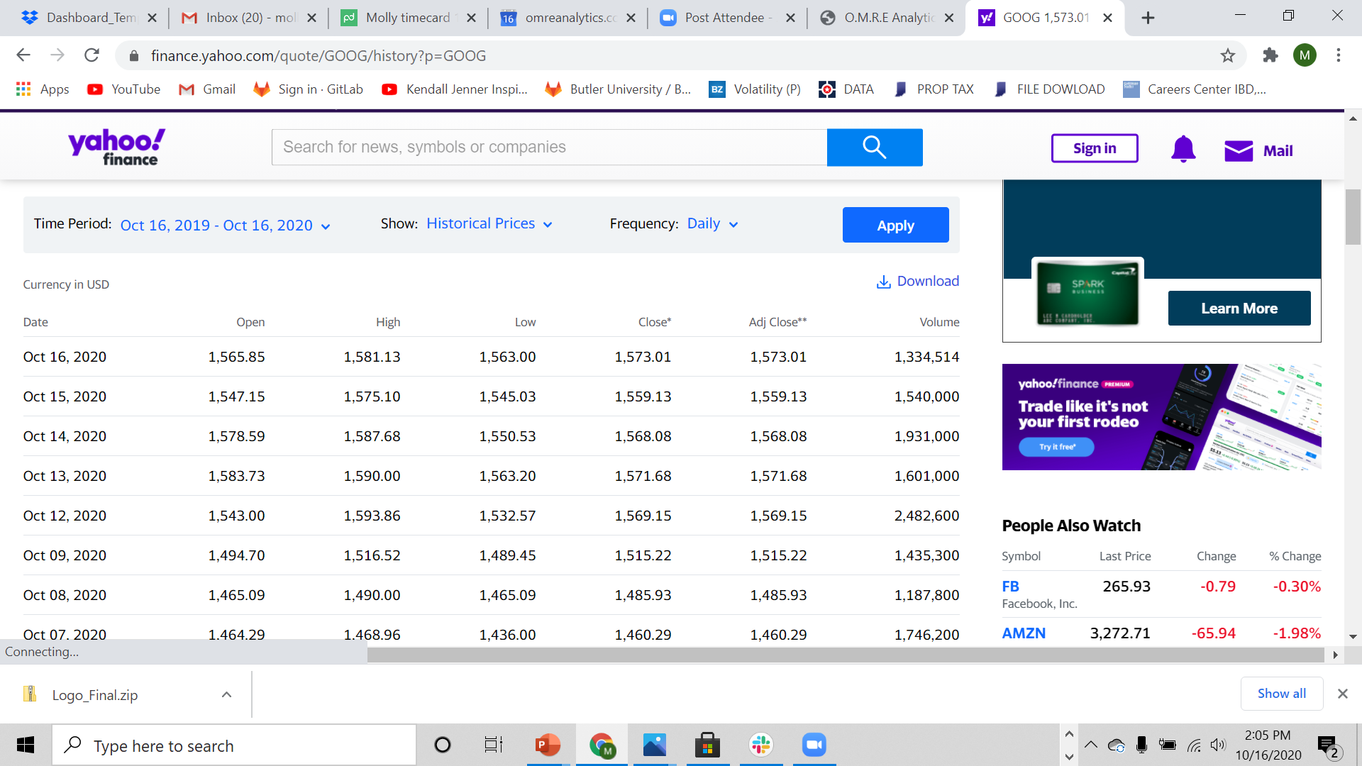
Data Source
Yahoo Finance Historical Stock Market Data

Slide 4
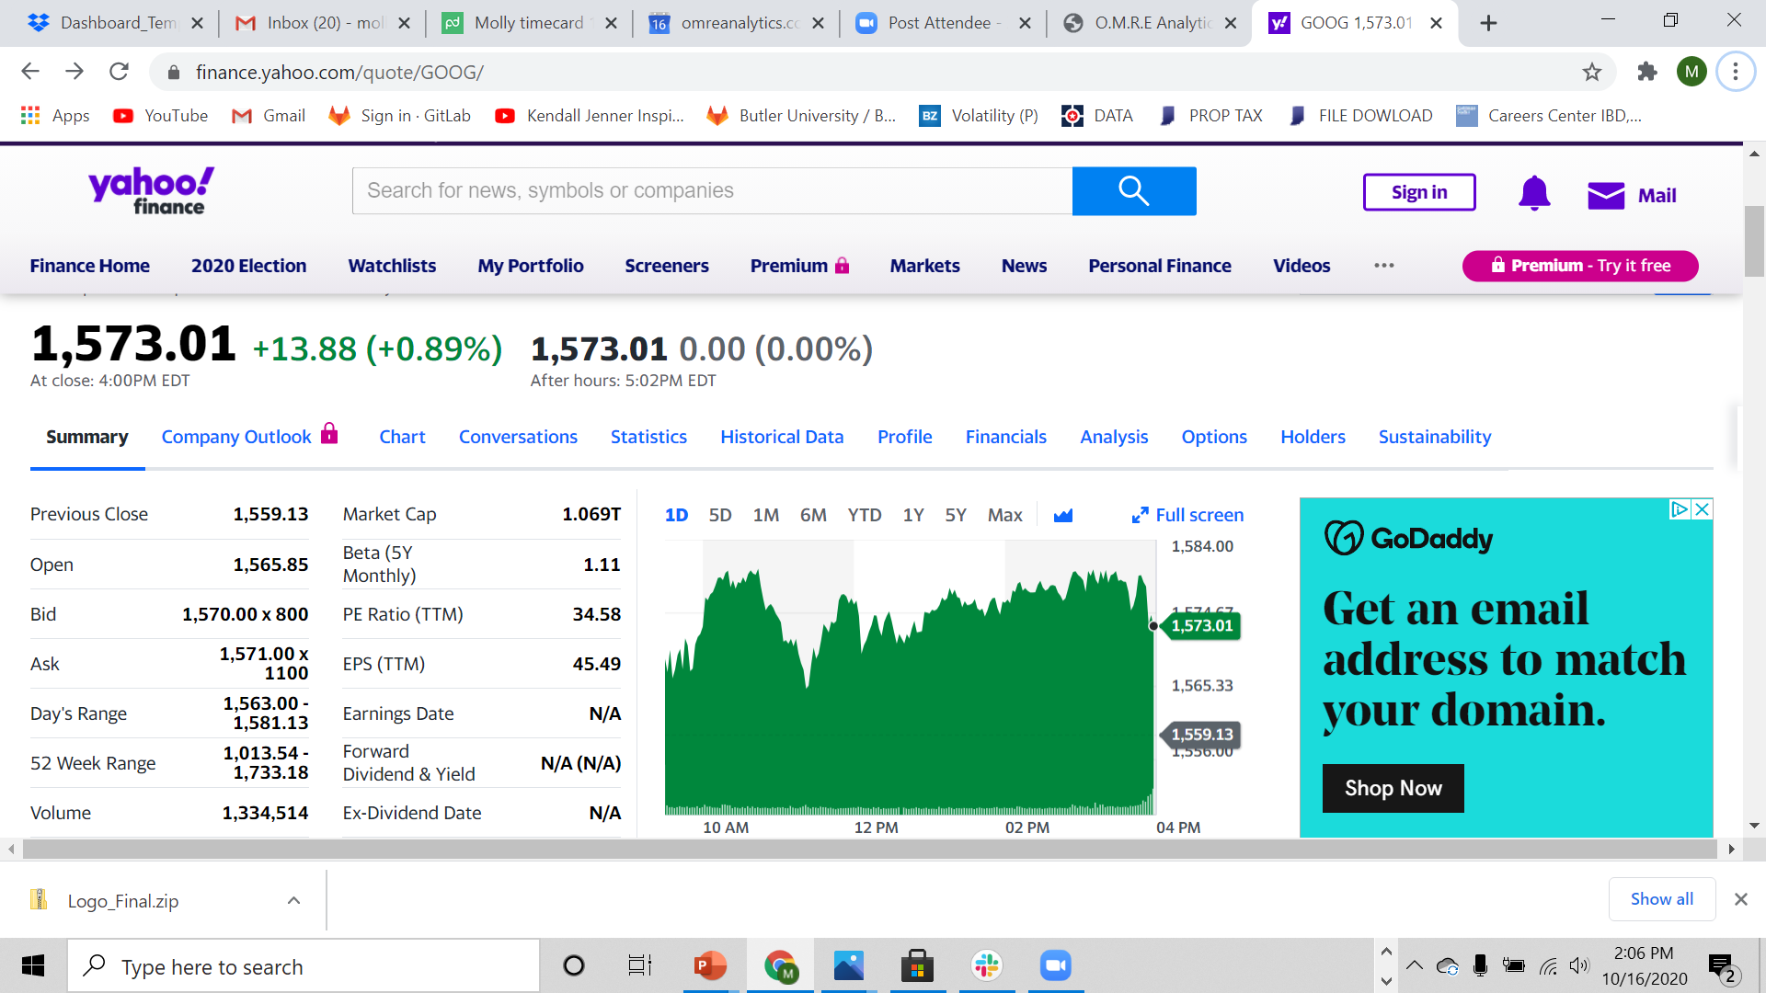
Data Visuals Inspiration

Slide 5
Project Overview
Database – MongoDB
Class - Dashboard with multiple charts that update from the same data
New JS Library – Chart.js
Over 100 Records – Yes
User Driven Interface – Drop down selection to choose a stock from each stock exchange
Three Views – Yes. One for a given stock on each of the three stock exchanes

Slide 6
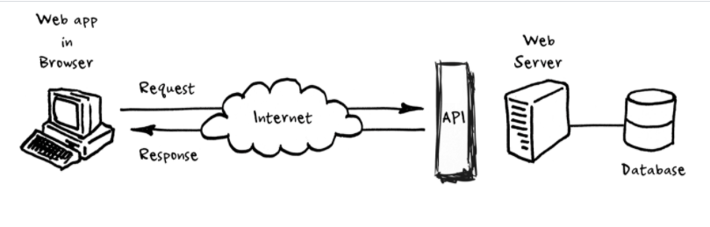
Our Process
Obtain historical stock market data from Yahoo Finance
Convert multiple CSV files into one
Use Python to send CSV data to MONGO database
Use Flask to create RESTful API
Use JavaScript, D3, plotly, and Chart.js to manipulate and plot the data
Use HTML and CSS to display visualizations
Use Atlas to deploy our database, and Heroku to deploy application

Slide 7
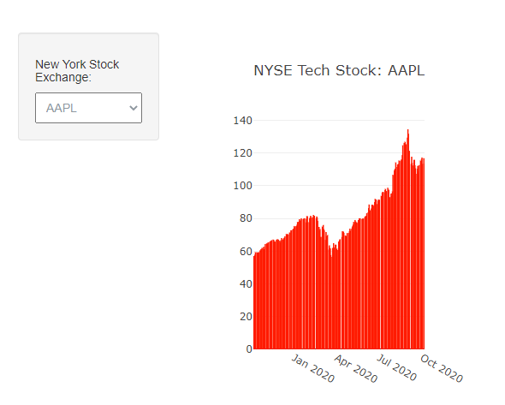
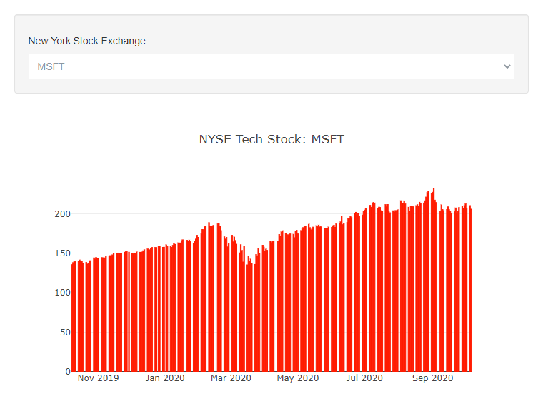
End Product: D3/plotly

Slide 8

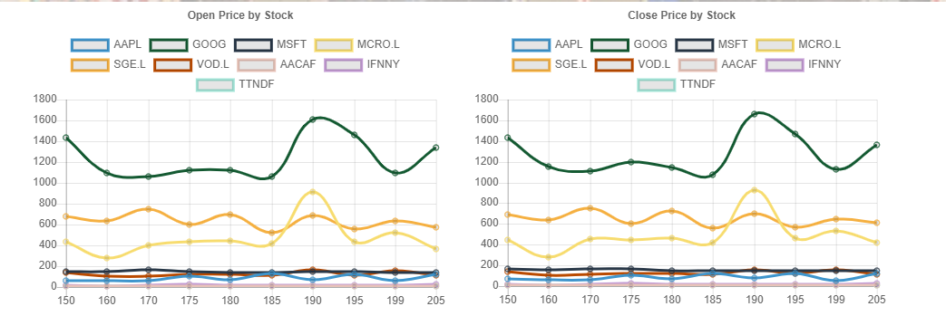
End Product: Chart.js

Slide 9
Challenges

Slide 10
Reflection
Things we wish we could have done or wish we had done better

